Slide 1
ATTEMPT THE IMPOSSIBLE FOR GOD. - Matthew 14:22-33
Pastor Rod Lago

Slide 2
Have you ever attempted the Impossible?

Slide 3
4 RULES IN ATTEMPTING THE IMPOSSIBLE?
I. DON’T GET COUNSEL FROM DISTRUCTORS. Proverbs 11:14
2 Timothy 3:5

Slide 4
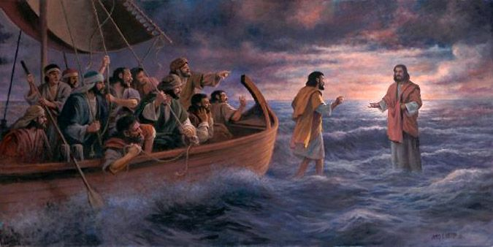
PROVERBS 11:14 (ESV)
Where there is no guidance, a people falls, but in an abundance of counselors there is safety.

Slide 5
2TIMOTHY 3:5
holding to a form of [outward] godliness (religion), although they have denied its power [for their conduct nullifies their claim of faith]. Avoid such people and keep far away from them.

Slide 7
LIFE APPLICATION:
“IF YOU ARE SERIOUS AND PASSIONATE IN ATTEMPTING IMPOSSIBLE THINGS FOR GOD, DON’T GET COUNSEL FROM DISTRUCTORS, AVOID SUCH PEOPLE AND KEEP AWAY FROM THEM.”

Slide 8
4 RULES IN ATTEMPTING THE IMPOSSIBLE
II. DON’T ATTEMPT IMPOSSIBLE WITH YOUR OWN STRENGTH.
John 15:5, Zechariah 4:6

Slide 9
John 15:5
“Yes, I am the vine; you are the branches. Those who remain in me, and I in them, will produce much fruit. For apart from me you can do nothing.

Slide 10
Zechariah 4:6
Then he said to me, “This is what the Lord says to Zerubbabel: It is not by force nor by strength, but by my Spirit, says the Lord of Heaven’s Armies.

Slide 11

LIFE OF sAMSON

Slide 12
LIFE APPLICATION:
“WHEN WE DEPEND ON GOD’S STRENGTH, WE WILL OVERCOME ALL THE HARDSHIPS OF LIFE AND NOTHING IN THIS WORLD THAT WE CANNOT DO BECAUSE GOD’S STRENGTH IS WITH US!”

Slide 13
4 RULES IN ATTEMPTING THE IMPOSSIBLE
III. DON’T STAY IN THE BOAT, TAKE RISK.
Matthew 14:28-29

Slide 14
Matthew 14:28-29
28 And Peter answered Him and said, “Lord, if it is You, command me to come to You on the water.”
29 So He said, “Come.” And when Peter had come down out of the boat, he walked on the water to go to Jesus.

Slide 15
Getting out from your Boat means Getting out from your Personal Comfort zones. And this Comfort zones are the following:
Getting out from our Personal Cultures or Lifestyle.
Getting out from our Personal Standards.
Getting out from our Personal Hobbies.
Getting out from our Personal Beliefs.

Slide 16
Why do people TAKE RISK?
OPPORTUNITY. – Risk can open doors to new Opportunities and experiences.
GROWTH. – Stepping outside your comfort zone can lead to Personal and Professional Growth.
INNOVATION. – Taking Risk is often necessary for Innovation and Progress.

Slide 17



Example: investing in stocks market, starting a new business, courtship

Slide 18
LIFE APPLICATION:
“IT IS IMPORTANT TO REMEMBER THAT GOING OUT FROM OUR COMFORT ZONES AND TAKING RISKS SPECIALLY FOR GOD IS ALWAYS A GOOD IDEA. BUT WHEN IT COMES TO OUR PERSONAL DREAMS AND LIFE’S CHOICES, WE SHOULD ALWAYS CAREFULLY CONSIDER THE POTENTIAL BENEFITS AND DRAWBACKS BEFORE MAKING DECISIONS.

Slide 19
4 RULES IN ATTEMPTING THE IMPOSSIBLE
IV. DON’T FOCUS ON THE CIRCUMSTANCES, INSTEAD FOCUS ON JESUS.
Matthew 14:30-33

Slide 20
Matthew 14:30-33
30 But when he saw the wind, he was afraid and, beginning to sink, cried out, “Lord, save me!”
31 Immediately Jesus reached out his hand and caught him. “You of little faith,” he said, “why did you doubt?”
32 And when they climbed into the boat, the wind died down. 33 Then those who were in the boat worshiped him, saying, “Truly you are the Son of God.”

Slide 21
LIFE APPLICATION:
“ALWAYS REMEMBER THAT GOD IS NOT YET DONE, HE IS CONTINUALLY WORKING WITH US! EXPECT GREATER THINGS FROM GOD AND ATTEMPT GREATER THINGS FOR JESUS!”

